Slide 1
Innovation Practices
0th review presentation

Slide 2
Team members:
Indra Shekar G (19z219)
Sanjai M (19z241)
Soumen Saha (19z245)
Vivekanandan (19z261)
Manoj S (19z263)
Guide:
Ms. A. Bharathi, Asst. Professor
Department of Computer Science And Engineering

Slide 3
Outline
Problem Statement
Industry
Motivation
Objective
Literature Survey
References

Slide 4
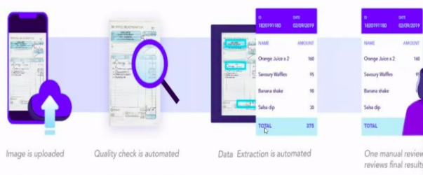
Problem Statement
Topic : Healthcare Document Data Capture
Description : Capture all invoice content and particulars in any type of invoices with any format.

Slide 5
Industry - ShlokLabs
SHLOKLABS is a software and web/mobile development company headquarted in Lisbon, Portugal, founded in 2003. It aims to provide the best solutions for complex business problems.

Slide 6
Motivation
Text extraction from any handwritten document tends to have problems when it comes to accuracy. Even we sometimes struggle to read others’ handwriting. How, then, is a computer going to do it?
The issue is that there’s a wide range of handwriting – good and bad. This makes it tricky enough to get examples of how every character might look. Plus, sometimes, characters look very similar, making it hard for a computer to recognise accurately.

Slide 7
Joined-up handwriting is another challenge for computers. When your letters all connect, it makes it hard for computers to recognise individual characters. Consider, for instance, an ‘r’ and an ‘n’. Joined up, these letters could be mistaken for an ‘m’.
In the case of handwriting recognition from photos, there are also awkward angles to consider. The angle the photo is taken could obscure the character, making it harder for the computer to identify.

Slide 8
Objective
To create character and word based neural network models using the available datasets like IAM dataset. Evaluate the models with their accuracies and picking the best one.
Pre-process the input invoice image using OpenCV and converting it into formatted digital document using the model we created.
Then extracting the whole text from the digital document using existing models like pytesseract, vision, etc.

Slide 9
1. VGG-19: VGG-19 is a 19-layer deep Convolutional Neural Network (CNN). It is pre-trained model trained on more than a million images from the ImageNet database. 2. RESNET-18: RESNET is a 18-layer deep Convolutional Neural Network used for object detection. 3. RESNET-34: RESNET-34 is a 34 layer Convolutional Neural Network that can be utilised as a state-of-art image classification model.
Literature Survey
Some of the previously used models for text industry

Slide 10
References
https://blog.hexstream.com/process-handwritten-text-using-python-and-cloud-vision
https://medium.com/@derrickfwang/printed-and-handwritten-text-extraction-from-images-using-tesseract-and-google-cloud-vision-api-ac059b62a535
https://github.com/DerrickFeiWang/HandwritingRecognition_GoogleCloudVision

Slide 11
https://pyimagesearch.com/2020/08/24/ocr-handwriting-recognition-with-opencv-keras-and-tensorflow/
https://nanonets.com/blog/deep-learning-ocr/
https://towardsdatascience.com/build-a-handwritten-text-recognition-system-using-tensorflow-2326a3487cd5

Slide 12
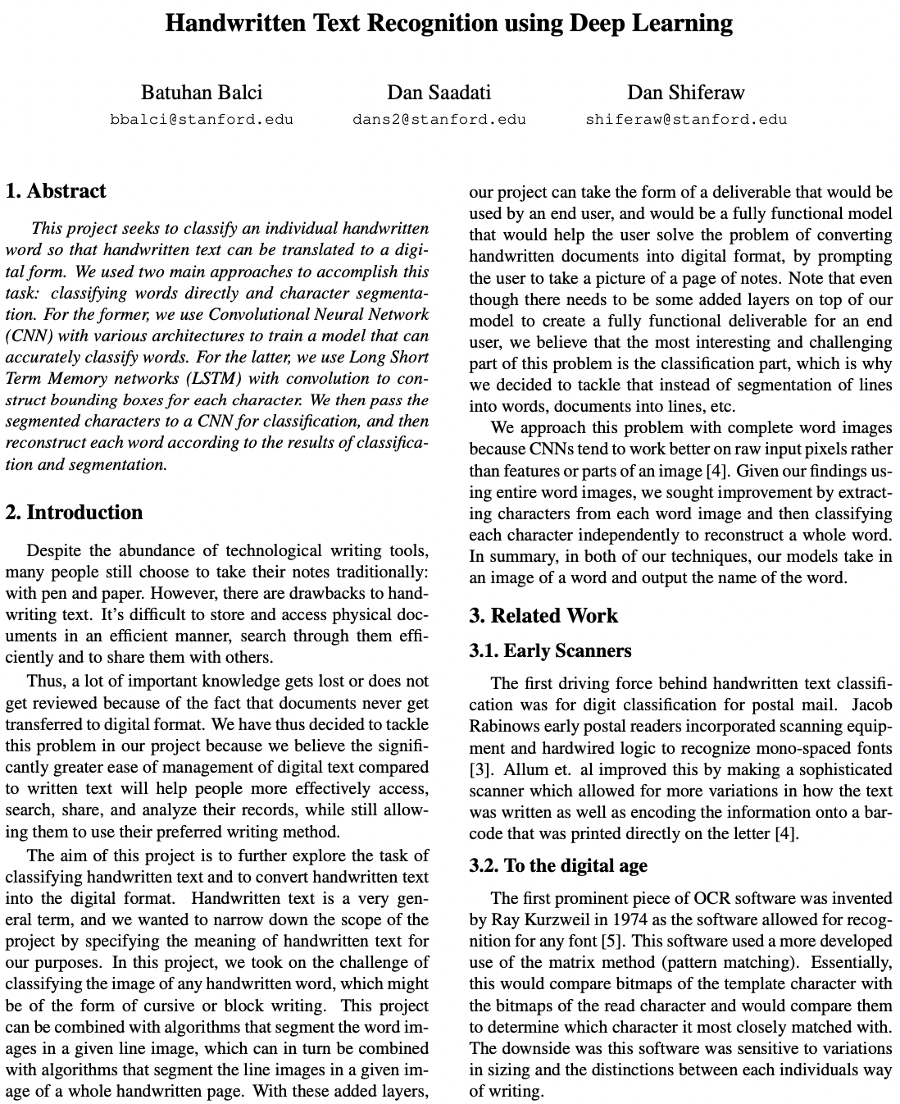
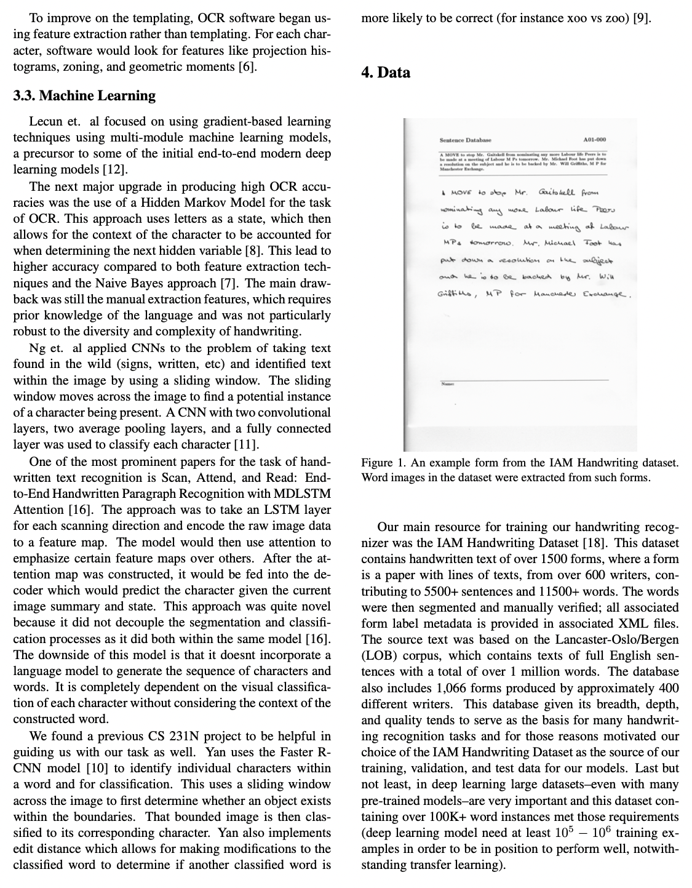

Slide 13
Thank you

